Slide 12
Stop here
Continue Lecture here tomorrow – 7/15

Slide 22
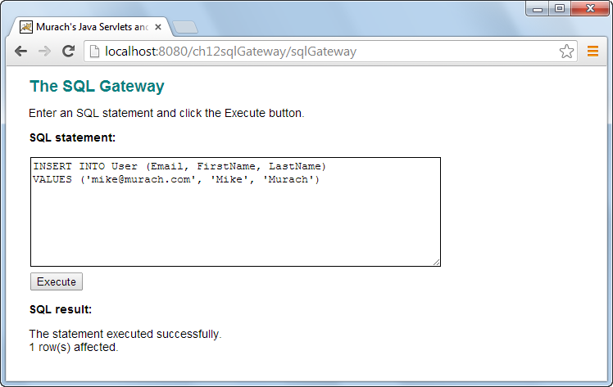

Slide 23
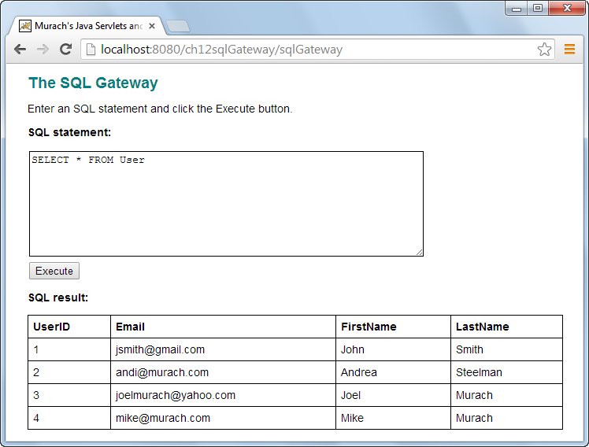

Slide 33
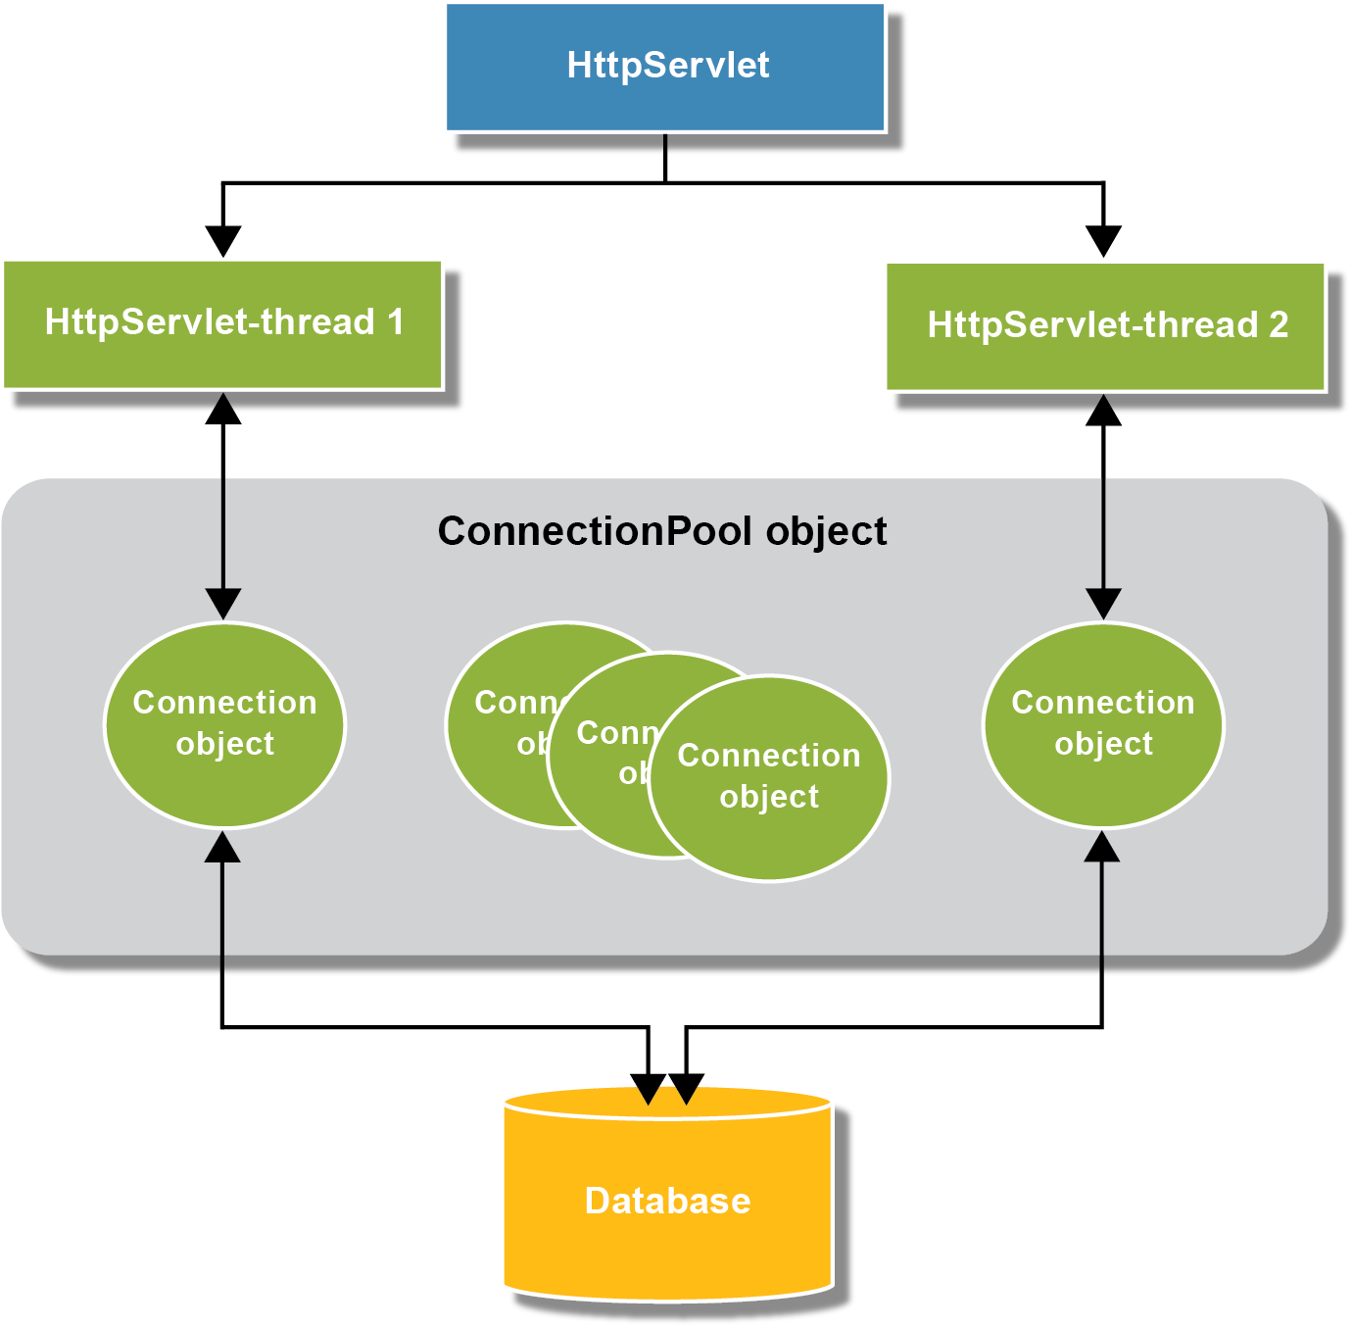

Slide 40
